Slide 1


What factors influence housing prices, have they changed overtime?
Springboard data science Capstone 2
Prince Zogli, PhD
Mentors: Eleanor Thomas, Reza Farahani

Slide 2

The Problem:
Modern day Housing prices are known to be driven by factors such as Demographics, interest rates, government policies and the economy.
However, it is not clear whether these factors were key real estate price determinants.

Slide 3

Why use Boston Housing data
The Boston housing data is a classic dataset obtained published in 1978 on 506 houses with median prices.
The data is made of features such as structural quality, neighborhood, accessibility and air pollution such as per capita crime rate by town, proportion of non-retail business acres per town, student-to-teacher ratio, proximity to water bodies, demographic and index of accessibility to radial highways.
Given that this data was obtained 43 years ago, it is a good resource to gauge how determining factors of real estate prices have changed over the past 40 years.

Slide 4
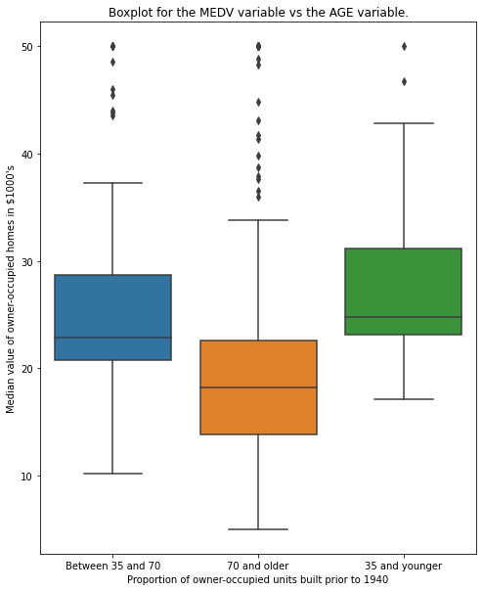
Homes 35 and under have better value than homes 35 and above.
As expected very old homes are valued less.

Slide 5
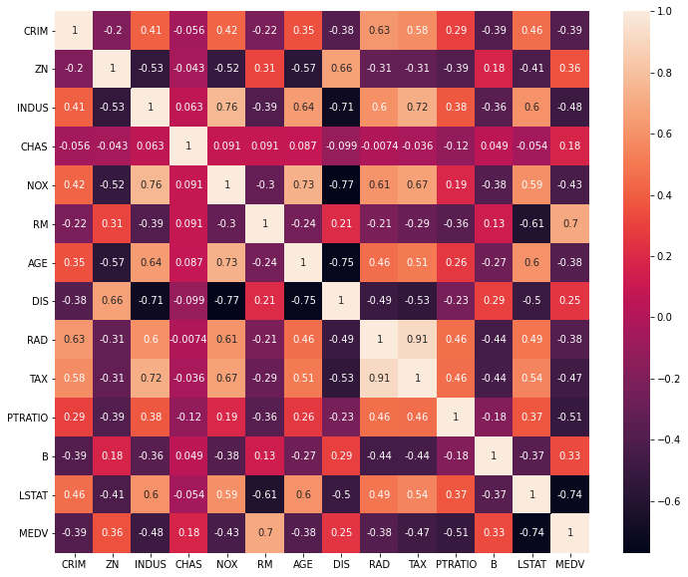
Correlation among features
LSTAT, INDUS, RM, TAX, NOX, and PTRAIO have correlation scores about .40 and above with MEDV
RAD and TAX are highly correlated features

Slide 6
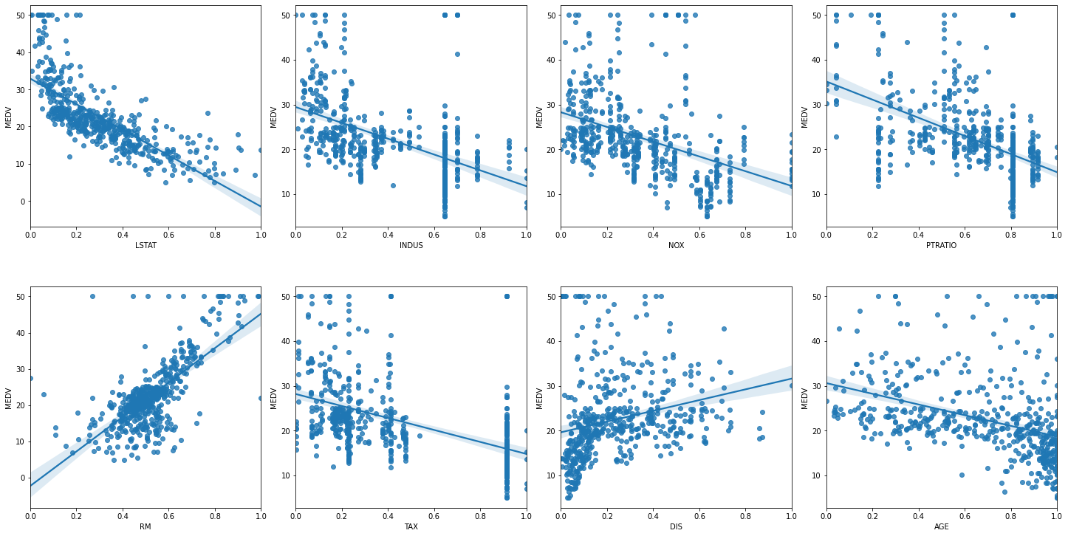
Scatter Plot showing the correlation among top features
Most selected features negatively impact prices except for number of rooms(RM) and zdistance to 5 Boston employment centers(DIS).

Slide 7
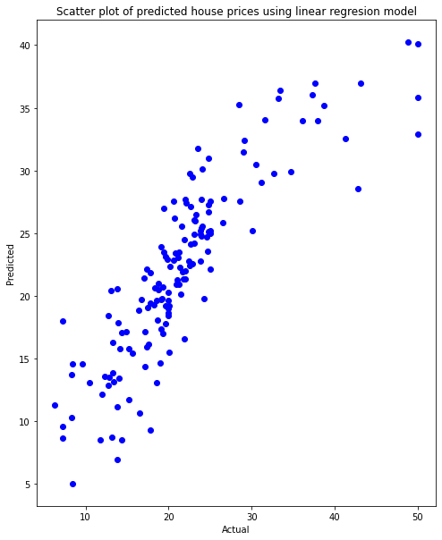
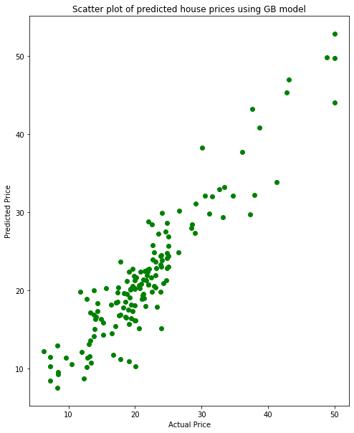
Gradient Boosting model performs better than Linear model

Slide 8
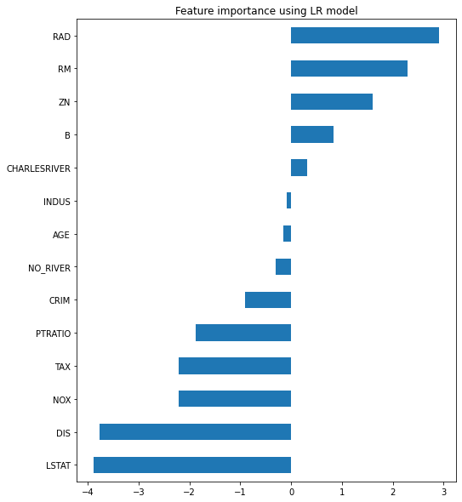
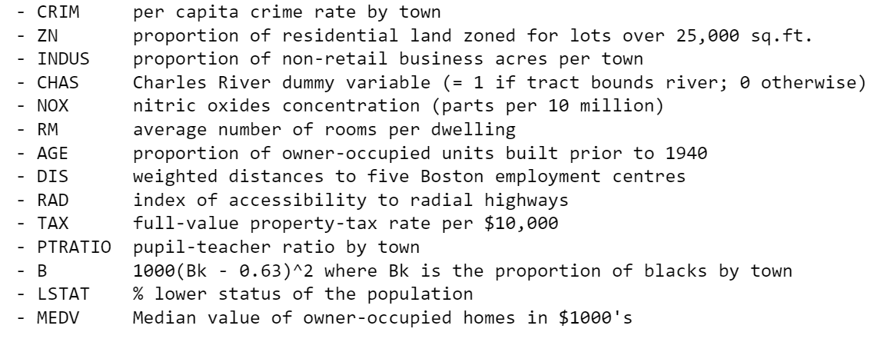
Good predictors of housing prices
Features like LSAT, DIS, NOX, RAD, RM, PTRATIO, CRIM and Tax

Slide 9
Conclusion and future derections
Gradient boosting model works better than Linear model
LSAT, DIS, NOX, RAD, RM, PTRATIO, CRIM and Tax impact prices.
Drop some features for further training of the model

Slide 10
Questions?
Thank you

